Slide 1
INFO 5709 – Data Visualization AND COMMUNICATION Topic: WORLD EDUCATIONAL DATA
Soumya Vardhana Gari
11711707
Professor: Mr. Gahangir Hossain

Slide 2
Contents:
Introduction
Cleaning and Exploring the dataset.
Exploratory Data Analysis
Data Visualization Graphs – Hypothesis
Scatter Plot
Line Chart
Bar Chart
Symbol Maps
Side By Side Chart
Dashboard
Conclusion

Slide 3
Introduction
The chosen dataset global education contains an extensive perspective of educational systems worldwide, offering significant insight regarding the evolving context of educational institutions in numerous countries and territories.
Generally, it covers significant factors for things like not attending schools, rate of graduation, skill levels of difficulty, levels of literacy, fertility rates, and about both elementary and secondary school admission individuals, which comprises quite a few issues related to education.
This collection of data represents a valuable tool to perceptive intellectuals, motivated instructors, ultimately enlightened officials, presenting the knowledge and skills to individuals to begin a groundbreaking method of monitoring, evolving, and changing educational organizations beyond the world.

Slide 4
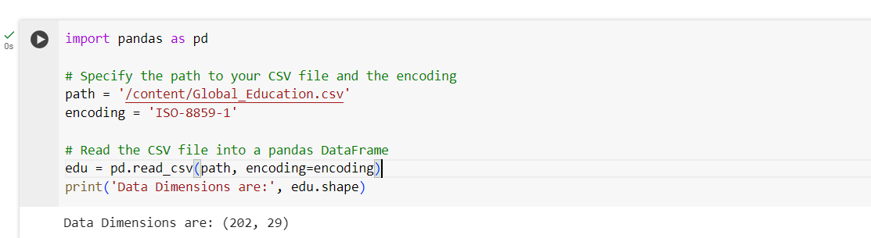
Cleaning and exploring the dataset
The dataset which I have chosen is from Kaggle. The dataset consists the information about educational systems of various countries from different parts of world.
This dataset consists of 203 rows which provides data about 202 countries. This dataset consists of about 29 attributes. The link is provided in the below following: https://www.kaggle.com/datasets/nelgiriyewithana/world-educational-data/data
To read Global_Education.csv file in Python, the Pandas library is used as represented below.

Slide 5
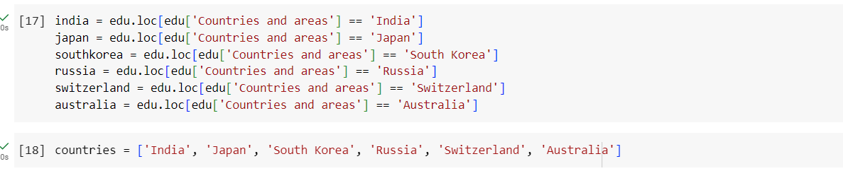
Exploratory Data ANALYSIS - PYTHON
To perform exploratory data analysis, let us consider some countries and regions from the dataset and perform analysis on evaluating the status of education identifying significant factors. Some of the countries which are chosen to analyze the data are India, Japan, Russia, South Korea, Switzerland, Australia.

Slide 6
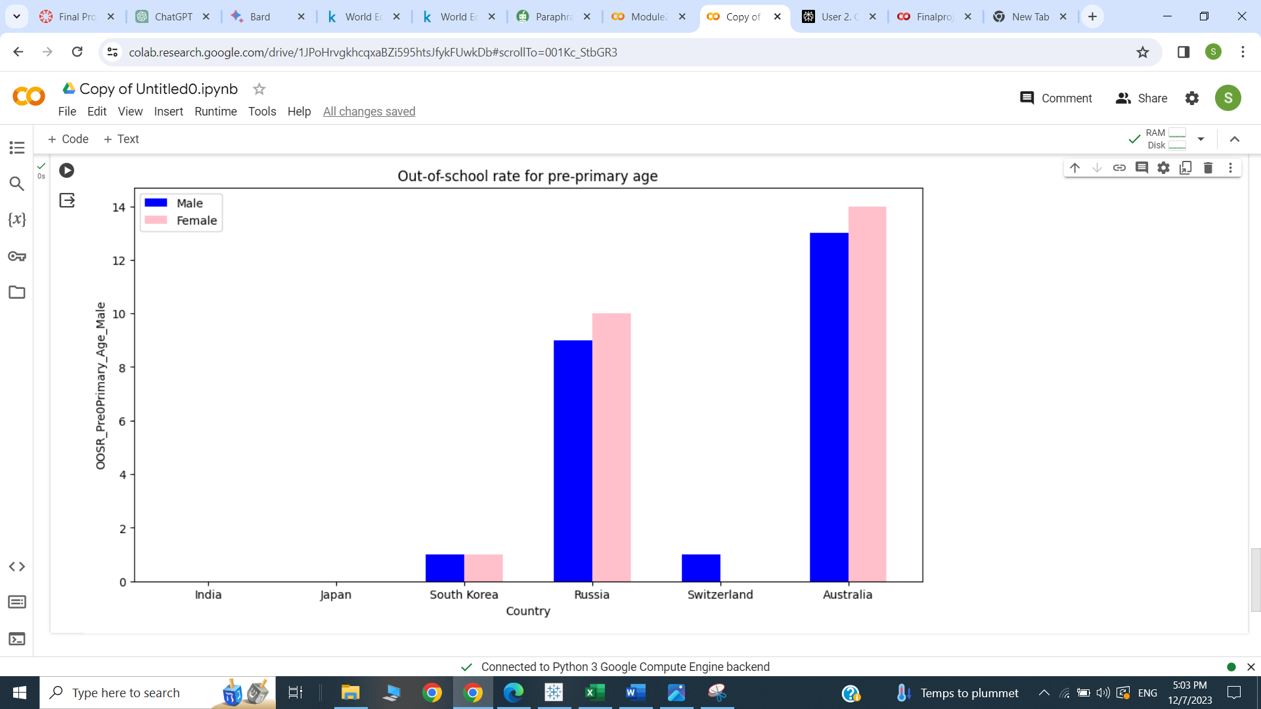
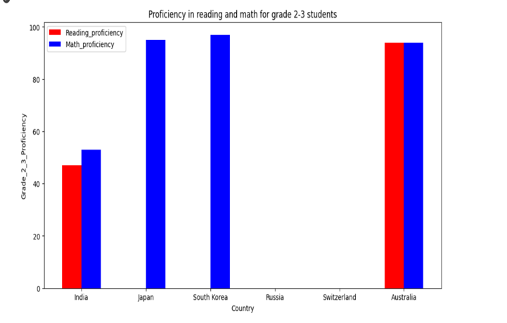
EDA - OOSR FOR PRE-PRIMARY AGE AND PROFICIENCY IN READING AND MATH FOR GRADE 2-3 STUDENTS

Slide 7
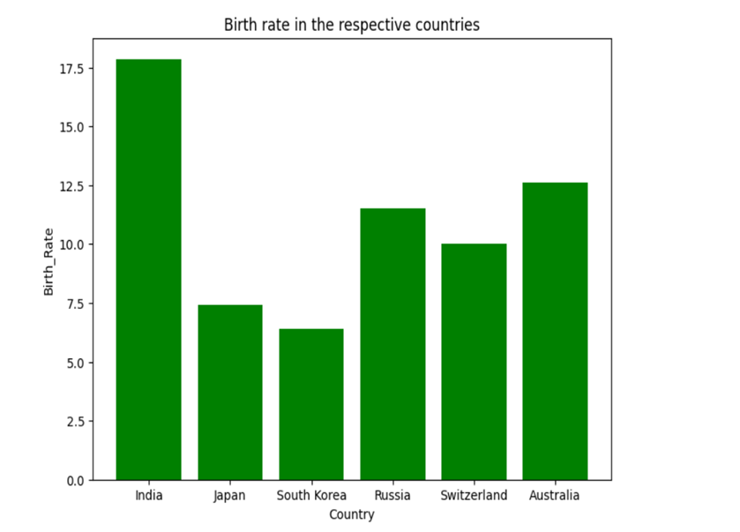
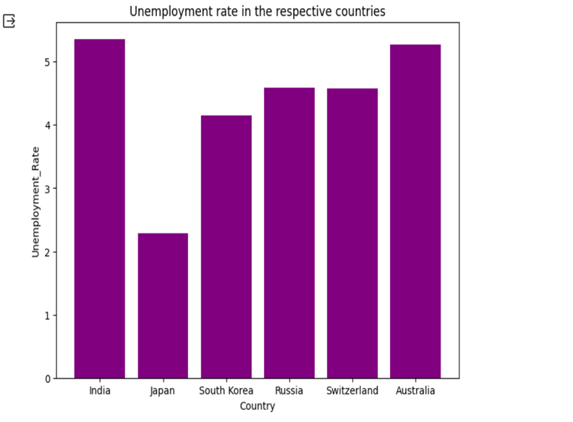
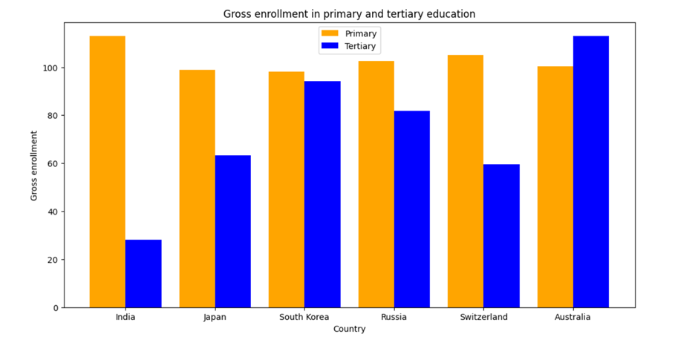
EDA – BIRTH RATE, UNEMPLOYMENT RATE, GROSS PRIMARY EDUCATION AND GROSS TERTIARY EDUCATION ENROLLMENTS

Slide 8
DATA VISUALIZATION - HYPOTHESIS
Is there any relationship between birth rate and gross primary and tertiary education enrollments?
What is the average proficiency of grade 2-3 students in math and reading in each region?
Identify the out of school rates for upper secondary age male and female and analyze the highest and lowest among the countries.
Using interactive filters, find out and highlight all the measure values for the following countries chosen.
Find out the literacy rate in male and female for the countries chosen with adding interactive filter, Create a dashboard to display India literacy rate in youth from ages 15-24.

Slide 9
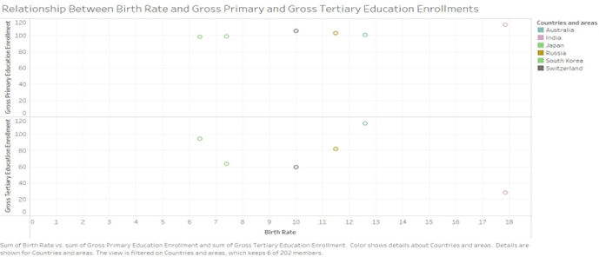
TABLEAU – SCATTER PLOT
The above scatter plot visualization depicts information about birth rate in different countries corresponding to their respective gross primary and gross tertiary education enrollments. With this visualization, the relationship between the attributes is possible. Hence the given above hypothesis is proved right.

Slide 10
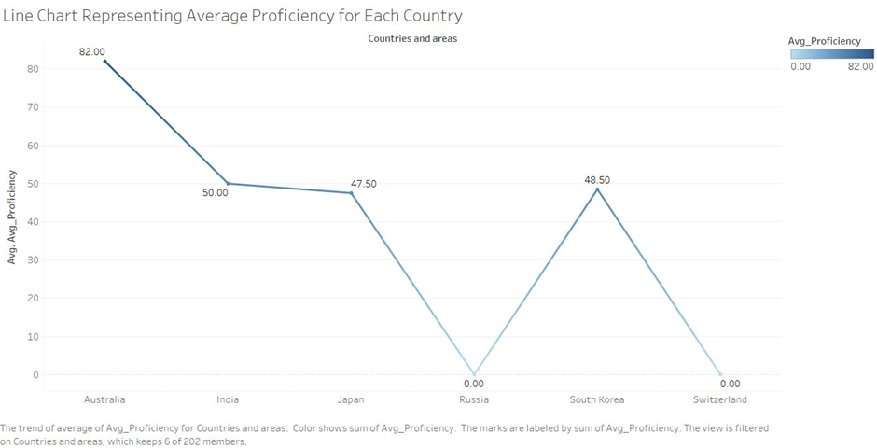
LINE CHART
In order to prove the second hypothesis, we created a line chart with the following attributes including Avg_Proficiency with Countries and regions. This average proficiency attribute gives the average between grade 2_3 proficiency in math and grade 2_3 proficiency in reading. With this data visualization, the resulted line chart helps us to find the average of proficiency of all the countries selected and it is observed that Australia has the highest average proficiency both in math and reading hence, second hypothesis also proves right with the above visualization.

Slide 11
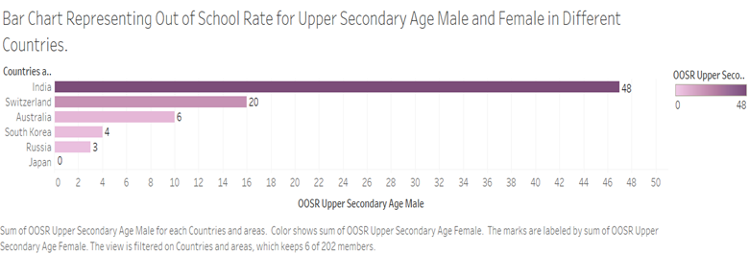
BAR CHART
The above bar chart represents the out of school rate for upper secondary male and female in different countries. It is observed that India country has the highest count of out of school rate observed in female and male of upper secondary age among the other countries.

Slide 12
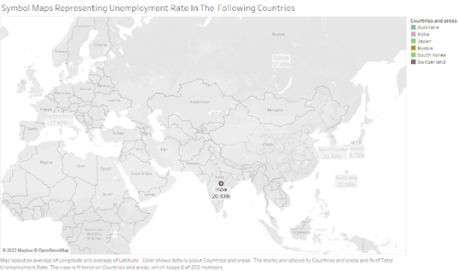
SYMBOL MAPS – USING HIGHLIGHT INTERACTIVE FILTER
To create a source sheet, a Symbol Map visualization graph is selected to be constructed using Latitude and Longitude attributes along with the countries and areas selected.
Add actions to the worksheet, select highlight action and choose select option and click ok. In this way, the highlight interactive filter is added to the visualization graph. Select the country and observe the result in the target sheet constructed.

Slide 13
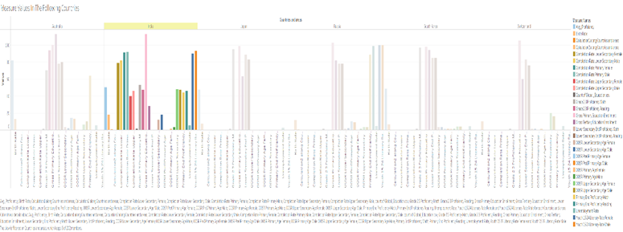
Side by side bar graph – USING HIGHLIGHT INTERACTIVE FILTER
To create a target sheet, a side by side bar visualization graph is selected to be constructed using measure names and measure values attributes along with the countries and areas selected.
After clicking on India, on the source sheet the changes are observed on target sheet. It displays only India’s education data which is the highlighted part.

Slide 14
Dashboard
One more visualization graph Pie chart is created.
Create a new dashboard. Drag and drop Scatter Plots sheet consisting data about birth rate, gross primary education and gross tertiary education enrollments at the first section of the page.
Drag and drop the other sheets side-by-side bar, bar chart, line chart and pie chart which are already created.
Go to Dashboard menu, click on actions. Add a new action. Select Filter and name the filter.
It displays the average proficiency calculated with line chart, the literacy rate of youth in ages between 15 and 24 both female and males are represented.
The out of school rates of upper secondary female and male ratio along with all the measuring values of attributes in the dataset are displayed.

Slide 15
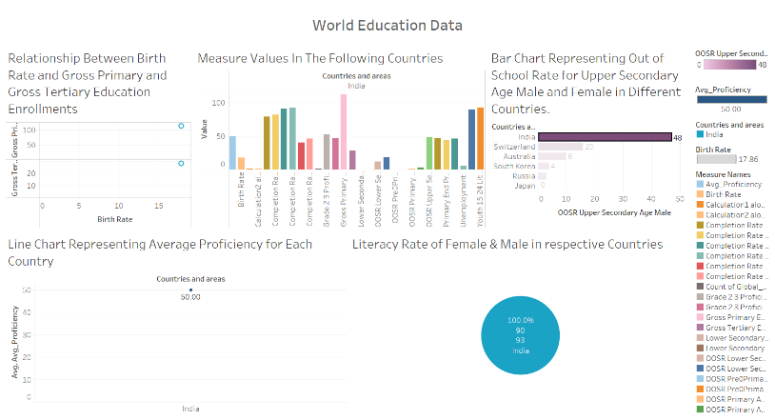
Result

Slide 16
Conclusion
This project helps us to analyze the dataset about education in different countries of the world.
It includes about the birthrate, gross primary and tertiary education enrollments, out of school rates of male and female, unemployment rate, literacy rate of youths.
Furthermore, it provides a clear understanding about educational aspects of data which are collected globally across the world.
FOR EXPLORATORY DATA ANALYSIS:
The link is given below:
https://colab.research.google.com/drive/1JPoHrvgkhcqxaBZi595htsJfykFUwkDb?usp=sharing

Slide 17
REFERENCES
"The Global Teacher Project". Globalteacher.org.uk. Retrieved 2015-05-20.
^ "What is global education? | GLEN". Glen-europe.org. Archived from the original on 2012-07-30. Retrieved 2015-05-20.
^ Global Education in the U.S. (n.d.). Retrieved April 24, 2016, from http://www.nea.org/home/37297.htm
Standish, Alex (2014). "What is global education and where is it taking us?". The Curriculum Journal. 25 (2): 166–186. doi:10.1080/09585176.2013.870081. S2CID 143384285.
Global Education in the U.S. (n.d.). Retrieved April 24, 2016, from http://www.nea.org/home/37297.htm

Slide 18
THANK YOU

